Slide 1
Email Etiquette and Netiquette

Slide 2
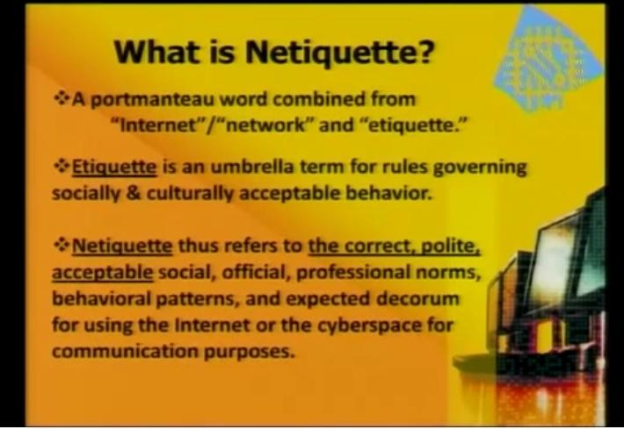

Slide 3
Rewrite the following email:
Hi sir,
V r intrstd in buying the latest microwaves manuf. by ur company. r u ready with supplies? Pl specify schdle of delivery 4 v cant w8 4 long.
sandeep sugam
for kingshood internationals

Slide 4
Corrected email
Dear Sir/Madam
We are interested in purchasing the latest microwaves (Model 371) launched recently by your company. We would like to know whether the product is ready to be supplied. Since we require microwaves as soon as possible please let us know by what time it would be possible to send us the consignment.
Thanks and soliciting the early reply!
Sandeep Sugam
Kingsfood Internationals

Slide 5
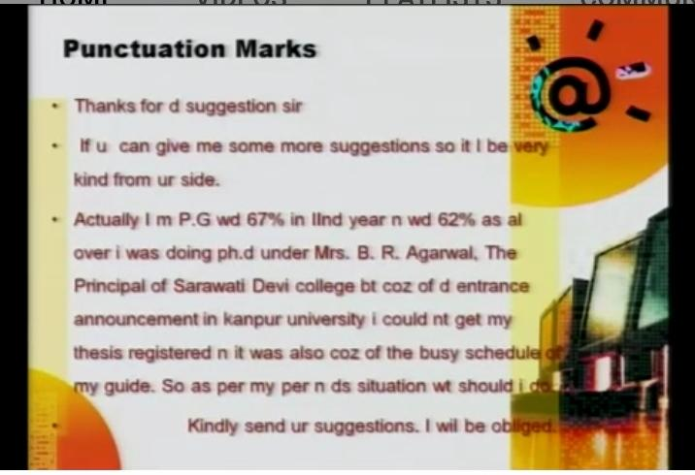

Slide 6
Introduction
The phenomenally rapid growth of the Internet and its widespread use in business has changed the way in which organizations communicate.
Many companies are promoting the use of email for most—if not all—in-house correspondence, and a great deal of communication with outside organizations also relies on email.
Email stands for electronic mail. These are digital messages that can be sent through an Internet connection.

Slide 7
Advantages
Email offers some tremendous advantages.
It is fast—a message can be sent to as many people as necessary instantaneously.
It is inexpensive, as it saves paper and is promoted in most organizations as a green initiative.
It is convenient and saves time.
When dealing with external agencies, especially important clients, it is the most unobtrusive mode of communication, as the recipients can read it at their own leisure and pace, and respond after due reflection.
Sounds, video clips, picture and other computer files can be attached.

Slide 8
Limitations
While email is an efficient way to communicate, it is also subject to limitations. In particular, we must realize when email is appropriate and when it is not.
For example, when writing about emotionally charged subjects (or when the person we are writing to may become angry, defensive, or otherwise upset about a subject, or when we are angry), a face-to-face conversation is generally more appropriate than email.
Similarly, discussing confidential matters or very complex issues is often better done in other ways than through email.

Slide 9
Contents of E-mail
Heading (date, to, subject, cc and bcc)
Salutation (Dear Mr/Mrs.., Dear Sir/Madam..)
Body (central idea of the mail)
Closing (Thanks and regards, Best wishes…)
Signature (only the writer’s name, Title & organisation)

Slide 10
Email Etiquette
There are many etiquette guides and many different etiquette rules. Some rules will differ according to the nature of the business and the corporate culture.
Here, we list what we consider as the 24 most important email etiquette rules that apply to nearly all formal communication situations.

Slide 11
Answer swiftly
People send an email because they wish to receive a quick response. If they did not want a quick response, they would send a letter or a fax. Therefore, each email should be replied to within at least 24 hours, and preferably within the same working day. If the email is complicated, just reply saying that the email has been received and that you will get back to them. This will put the reader’s mind at rest and usually they will then be very patient.

Slide 12
Do not overuse reply all
Use Reply All only if you really need your message to be seen by each person who received the original message.

Slide 13
Use templates for frequently used responses
If you often tend to receive the same queries, such as directions to your office or how to subscribe to your newsletter, save your replies as response templates and paste these into your message when you need them. You can save your templates in a Word document, or use pre-formatted emails. Even better is a tool such as ReplyMate for Outlook (allows you to use 10 templates for free).

Slide 14
Use proper structure and layout
Since reading from a screen is more difficult than reading from paper, the structure and layout are very important for email messages. Use short paragraphs and blank lines between each paragraph. When making points, number them or mark each point as separate to keep the overview.

Slide 15
Identify yourself and the topic
At the end of the message, include an alternative way to be contacted (i.e. phone number, FAX, postal address) along with the name. This information can be provided in a signature field that can be turned off for more personal emails. Providing contact information is especially important when asking for an answer that is likely to be quite complex. Often, less time is required to explain something complex over the phone or in person than to type out the message.
The information in the subject line should be meaningful to the recipient as well as the sender. For instance, when sending an email to a company requesting information about a product, it is better to mention the actual name of the product, e.g., ‘Product A information’, than to just say ‘Product information’ or the company’s name in the subject.

Slide 16
Answer all questions, and pre-empt further questions
An email reply must answer all questions, and pre-empt further questions. If all the questions in the original email are not answered, it will likely bring further emails regarding the unanswered questions, which will not only waste the time of the sender and the recipient but also cause considerable frustration. Moreover, if one is able to pre-empt relevant questions, the reader will be grateful and impressed with the sender’s efficiency and thoughtfulness.
Imagine for instance that an off campus student sends you (assume that you are a professor of Electronics Engineering) an email asking some doubts on a lesson. Instead of just explaining the answer to the student’s problem, if you mention some other sources that he/she can refer to for further understanding, the student will definitely appreciate this extra information.

Slide 17
Be concise and to the point
Do not make an email longer than it needs to be. Remember that reading an email is harder than reading printed communications and a long email can be very discouraging to read.

Slide 18
Use proper spelling, grammar, and punctuation
As in all forms of written communication, this is not only important—because improper spelling, grammar, and punctuation give a bad impression of the individual or the company— but also essential for conveying the message properly. For example, using u, r, and ur for you, are, and your respectively is inappropriate for formal messages. Mails with no full stops or commas are difficult to read and can sometimes even change the meaning of the text. If your program has a spell checking option, why not use it?

Slide 19
Do not write in CAPITALS
IF YOU WRITE IN CAPITALS IT SEEMS AS IF YOU ARE SHOUTING. This can be highly annoying and might trigger an unwanted response in the form of a flame mail. Therefore, try not to send any email text in capitals.

Slide 20
Avoid long sentences
Try to keep the sentences to a maximum of 15–20 words. Email is meant to be a quick medium and requires a kind of writing different from letters.

Slide 21
Use active instead of passive voice
Try to use the active voice of a verb wherever possible. For instance, ‘We will process your order today’ sounds better than ‘Your order will be processed today’. The first sounds more personal, whereas the latter, especially when used frequently, sounds unnecessarily formal.

Slide 22
Keep your language gender-neutral
It is important to be gender-sensitive. Apart from using he/she, you can also use the neutral gender: ‘The user should add a signature by configuring the email program’.

Slide 23
Maintain coherence
When replying to an email, include the original mail in the reply, Click ‘Reply’, instead of ‘New Mail’. Some people opine that the previous message must be removed since this has already been sent and is therefore unnecessary. However, if a person receives several emails, it is difficult to remember each individual email. This means that a ‘threadless email’ will not provide enough information and the recipient may have to spend a frustratingly long time to find out the context of the email in order to deal with it. Leaving the thread might take a fraction longer in download time, but it will save the recipient much more time and frustration in looking for the related emails in their inbox.

Slide 24
Do not overuse the high priority option
We all know the story of the boy who cried wolf. Overuse of the high-priority option will make it lose its function when really needed. Moreover, even if a message has high priority, it will come across as slightly aggressive if it is flagged as ‘high priority’.

Slide 25
Do not attach unnecessary files
Large attachments can annoy readers and even bring down their email system. Wherever possible, try to compress attachments and only send attachments when they are productive. Moreover, one should have a good virus scanner in place to prevent the readers from receiving documents containing viruses.

Slide 26
Re-read the email before you send it
A lot of people do not bother to re-read an email before they send it out, as can be seen from the many spelling and grammatical mistakes contained in emails. Besides, reading the email from the recipients’ perspective will help frame a more effective message and avoid misunderstandings and inappropriate comments.

Slide 27
Take care with abbreviations and emoticons
In business emails, try not to use abbreviations such as BTW and LOL. The recipient might not be aware of the meanings of the abbreviations, and in business emails these are generally not appropriate. The same goes for emoticons. It is advisable to avoid using any entities that the recipient might not be familiar with.

Slide 28
Be careful with formatting
Remember that when an email is formatted, the sender might not be able to view the formatting, or might see fonts that are different from the ones intended. When using colours, use a colour that is easy to read on the background. One also needs to be aware of the fact that there are some accessibility norms that do not allow the use of certain colours, keeping in mind colourblind people.

Slide 29
Take care with rich text and HTML messages
When sending an email in rich text or HTML format, be aware that the sender might be able to receive only plain text emails. If this is the case, the recipient will receive the message as a .txt attachment. Most email clients, however, including Microsoft Outlook, are able to receive HTML and rich text messages.

Slide 30
Do not use email to discuss confidential matters
Sending an email is like sending a postcard. Do not send confidential information by email. Moreover, never make any vilifying or discriminating comments in formal emails, even if they are meant to be jokes.

Slide 31
Avoid using URGENT and IMPORTANT
Even more so than the high-priority option, try to avoid the use of words such as ‘Urgent’ and ‘Important’ in an email or subject line. Use this only if it is a really, really urgent or important message.

Slide 32
Use the Bcc: field or do a mail merge
When sending an email, some people place all the email addresses in the To: field. There are two drawbacks to this practice:
(1) the recipient knows that the same message has been sent to a large number of recipients, and
(2) someone else’s email address is being publicized without their permission.
One way to get round this is to place all addresses in the Bcc: field. However, if the To: field appears blank, it might look like spamming to all the recipients. Instead, the list containing the email addresses of all recipients could be included in the To: field, or even better, with Microsoft Outlook and Word, it is possible to mail merge and create one message for each recipient.
A mail merge also allows the use of fields in the message so that each recipient can be addressed personally. For more information on how to do a Word mail merge, consult the Help feature in MS Outlook.

Slide 33
Using the cc field
The Bcc is used when a copy of the mail is to be sent to other recipients without the knowledge of the main recipient. For example, it is used in official correspondence such as appraisals being done by first-level managers. The first-level manager provides some feedback to his/her subordinate over email, but includes the second-level manager in Bcc, just for his/ her information. The subordinate doesn’t get to see that the email is also copied to the second level manager. This is mostly used for providing sensitive feedback that is supposed to be private.
Try not to use the Cc field unless the recipient in the Cc field knows why they are receiving a copy of the message. This will depend on the situation. Only the recipients in the To field are supposed to act on the message. The Cc field is used to keep others informed about the project, e.g. the manager or a co-worker.

Slide 34
Do not reply to spam
Replying to spam or unsubscribing confirms that the email address is ‘live’. Confirming this will only generate even more spam. Therefore, just hit the delete button or use email software to remove spam automatically.

Slide 35
Netiquette

Slide 36
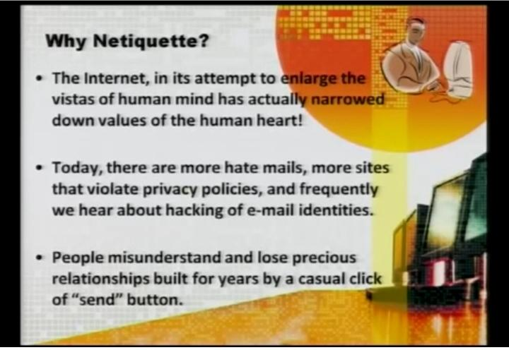

Slide 37
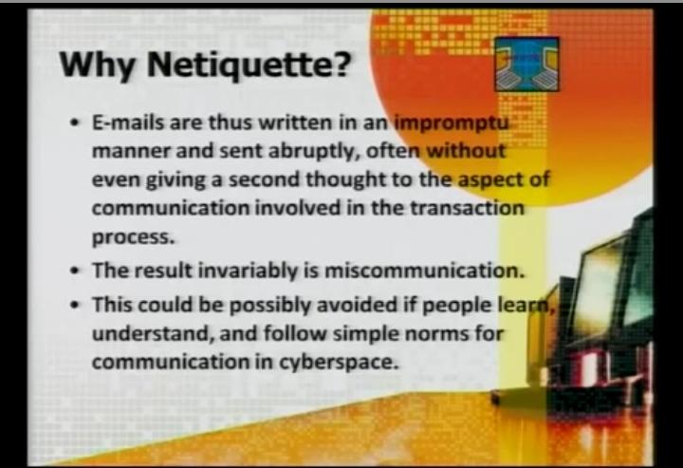

Slide 38
Netiquette
Netiquette, or network etiquette, is concerned with the “proper” way to communicate in an online environment. Consider the following “rules,” adapted from Virginia Shea’s The Core Rules of Netiquette, whenever you communicate in the virtual world.

Slide 39
Rule 1: Remember the Human
When communicating electronically, whether through email, instant message, discussion post, text, or some other method, practice the Golden Rule: Do unto others as you would have others do unto you. Remember, your written words are read by real people, all deserving of respectful communication. Before you press “send” or “submit,” ask yourself, “Would I be okay with this if someone else had written it?”

Slide 40
Rule 2: Adhere to the same standards of behavior online that you follow in real life
While it can be argued that standards of behavior may be different in the virtual world, they certainly should not be lower. You should do your best to act within the laws and ethical manners of society whenever you inhabit “cyberspace.” Would you behave rudely to someone face-to-face? On most occasions, no. Neither should you behave this way in the virtual world.

Slide 41
Rule 3: Know where you are in cyberspace
“Netiquette varies from domain to domain.” (Shea, 1994) Depending on where you are in the virtual world, the same written communication can be acceptable in one area, where it might be considered inappropriate in another. What you text to a friend may not be appropriate in an email to a classmate or colleague.

Slide 42
Rule 4: Respect other people’s time and bandwidth
Electronic communication takes time: time to read and time in which to respond. Most people today lead busy lives, just like you do, and don’t have time to read or respond to frivolous emails or discussion posts. As a virtual world communicator, it is your responsibility to make sure that the time spent reading your words isn’t wasted. Make your written communication meaningful and to the point, without extraneous text or superfluous graphics or attachments that may take forever to download.

Slide 43
Rule 5: Make yourself look good online
One of the best things about the virtual world is the lack of judgment associated with your physical appearance, sound of your voice, or the clothes you wear (unless you post a video of yourself.) You will, however, be judged by the quality of your writing.

Slide 44
Rule 6: Share expert knowledge
The Internet offers its users many benefits; one is the ease in which information can be shared or accessed and in fact, this “information sharing” capability is one of the reasons the Internet was founded. So in the spirit of the Internet’s “founding fathers,” share what you know! When you post a question and receive intelligent answers, share the results with others. Are you an expert at something? Post resources and references about your subject matter. Recently expanded your knowledge about a subject that might be of interest to others? Share that as well.

Slide 45
Rule 7: Help keep flame wars under control
What is meant by “flaming” and “flame wars?” “Flaming is what people do when they express a strongly held opinion without holding back any emotion.” (Shea, 1994). As an example, think of the kinds of passionate comments you might read on a sports blog. While “flaming” is not necessarily forbidden in virtual communication, “flame wars,” when two or three people exchange angry posts between one another, must be controlled or the camaraderie of the group could be compromised. Don’t feed the flames; extinguish them by guiding the discussion back to a more productive direction.

Slide 46
Rule 8: Respect other people’s privacy
Depending on what you are reading in the virtual world, be it an online class discussion forum, Facebook page, or an email, you may be exposed to some private or personal information that needs to be handled with care. Perhaps someone is sharing some medical news about a loved one or discussing a situation at work. What do you think would happen if this information “got into the wrong hands?” Embarrassment? Hurt feelings? Loss of a job? Just as you expect others to respect your privacy, so should you respect the privacy of others. Be sure to err on the side of caution when deciding to discuss or not to discuss virtual communication.

Slide 47
Rule 9: Don’t abuse your power
Just like in face-to-face situations, there are people in cyberspace who have more “power” than others. They have more expertise in technology or they have years of experience in a particular skill or subject matter. Maybe it’s you who possesses all of this knowledge and power! Just remember: knowing more than others do or having more power than others may have does not give you the right to take advantage of anyone. Think of Rule 1: Remember the human.

Slide 48
Rule 10: Be forgiving of other people’s mistakes
Not everyone has the same amount of experience working in the virtual world. And not everyone knows the rules of netiquette. At some point, you will see a stupid question, read an unnecessarily long response, or encounter misspelled words; when this happens, practice kindness and forgiveness as you would hope someone would do if you had committed the same offense. If it’s a minor “offense,” you might want to let it slide. If you feel compelled to respond to a mistake, do so in a private email rather than a public forum.

Slide 49
Add a warm-up sentence
Dear Chaitnya
No issues with the proposal sent. We’ll clear it in the meeting this evening.
Aninda

Slide 50
Rewrite the following email in a courteous tone
Dear Yashpal
You have not yet informed me about your availability for a tour to Delhi next week. I have to fix the schedule and make travel plans for all. So, why don’t you send the same immediately.
Pratika

